Slide 1
GNF (Lemma 2)
---Sakshi Surve

Slide 2
Normal Forms:
By reducing the grammar, the grammar gets minimized but does not get
standardized.
This is because the RHS of productions have no specific format.
In order to standardize the grammar, normalization is performed using
normal forms.

Slide 3
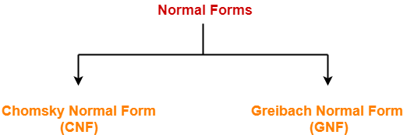

Slide 4
Greibach Normal Form (GNF) :
GNF stands for Greibach Normal Form.
A CFG(context free grammar) is in GNF(Greibach normal form) if all the production rules satisfy one of the following conditions:
  A non-terminal generating a terminal.
    A → a.
  A non-terminal generating a terminal which is followed by any number of non-terminals.
    S → aA.
    A → bD₁…D_{n}

Slide 5
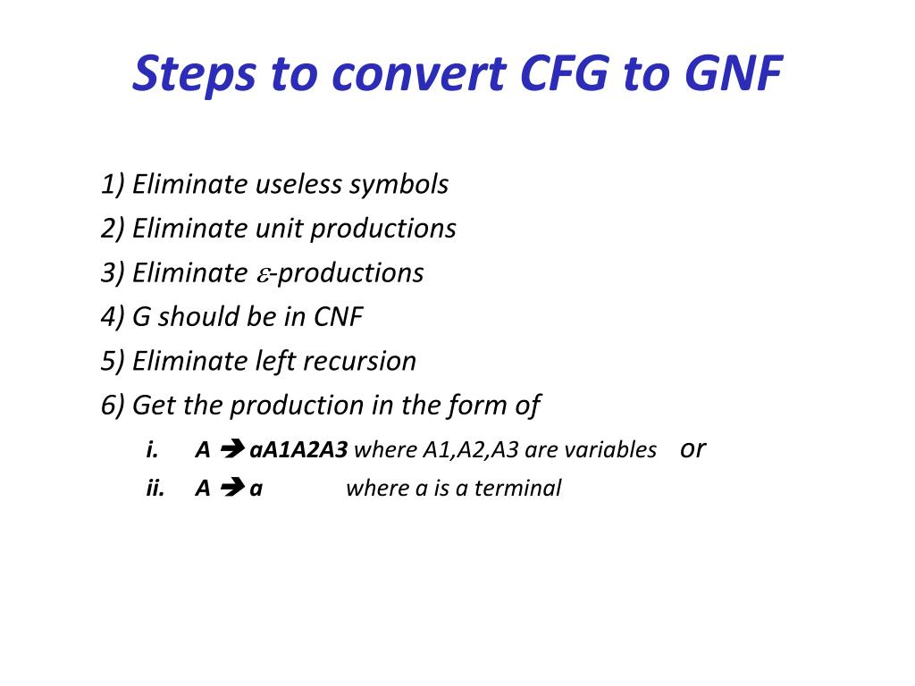

Slide 6
Lemma 1: Substitution Rule
If G is a grammar with productions
  A → Ba
  B → B₁ | B₂ | B₃ | …B_{n}
  Then, the CFG can be converted to GNF as
  A → B₁a | B₂a | …..B_{n}a

Slide 7
Lemma 2 : Removal of Left Recursion
This is applicable for removing Left Recursion present in the Grammar
  A → Aa₁ | Aa₂ | Aa₃| ………| Aa_{n} |B₁ | B₂|…..B_{n}
Equivalent GNF will be :
  A → B1 | B2 | B3…..| Bn
  A → B1Z | B2Z | B3Z | …….Bn Z
  Z → a1 | a2 | a3 ….. | an
  Z → a1 Z| a2Z |a3Z |….|anZ
Remove the rule with direct Left Recursion and, create a new one with recursion on right
E.g. Before A → Aa | b
  After A → bZ | b
  Z → aZ | a
E.g. Before A → Aa | Ab | b | c
  After A → bZ | cZ | b | c
  Z → aZ | bZ | a | b

Slide 8
6. Find GNF equivalent to given CFG
S→ SS | aSB | aB
B → b
Step 1: Grammar is simplified
Step 2 : Checking for each production for GNF
  B→ b ……………. 1 in GNF
  S→ SS | aSB | aB
  Now, S is in Left Recursion
  S→ aSB | aB | aSBZ | aBZ ……… 2
  Z → S | SZ…………………..Adding a new Variable by
  applying Lemma 2
  e) Now, S is in GNF

Slide 9
Z is not in GNF
To make Z in GNF apply Lemma 1 , substitute production of S
Z → aSB | aSBZ | aB | aBZ | aSBZ | aSBZZ | aBZ | aBZZ
………. 3
New Grammar G’ is :
G’ = { (A,S,B) , S , P, (a,b) }
P ➔
S→ aSB | aB | aSBZ | aBZ
Z → aSB | aSBZ| aB | aBZ | aSBZ | aSBZZ | aBZ | aBZZ
  B → b

Slide 10
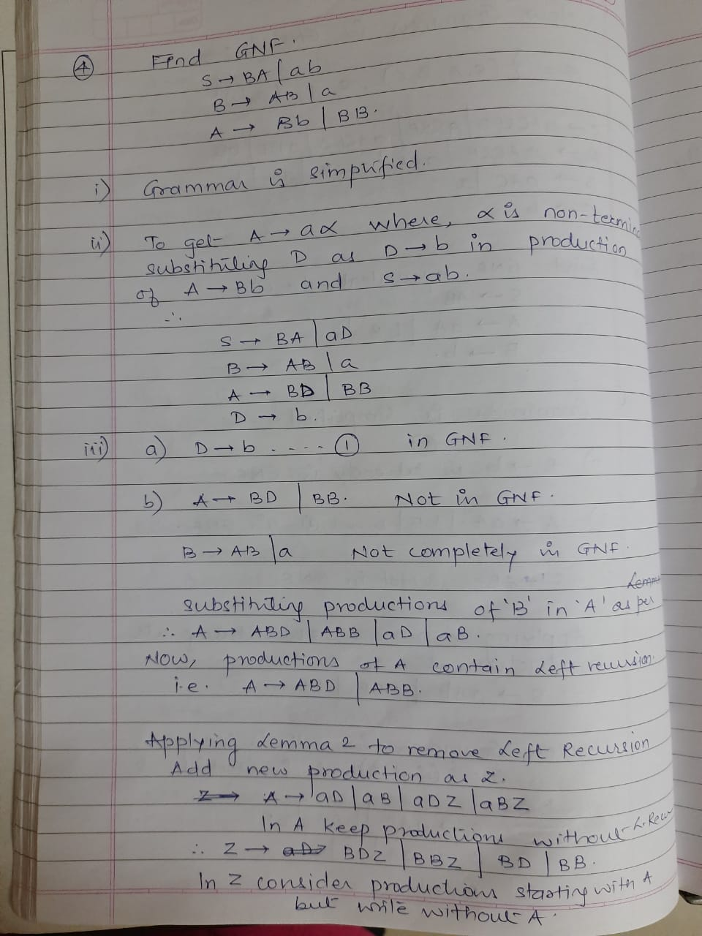
7

Slide 12
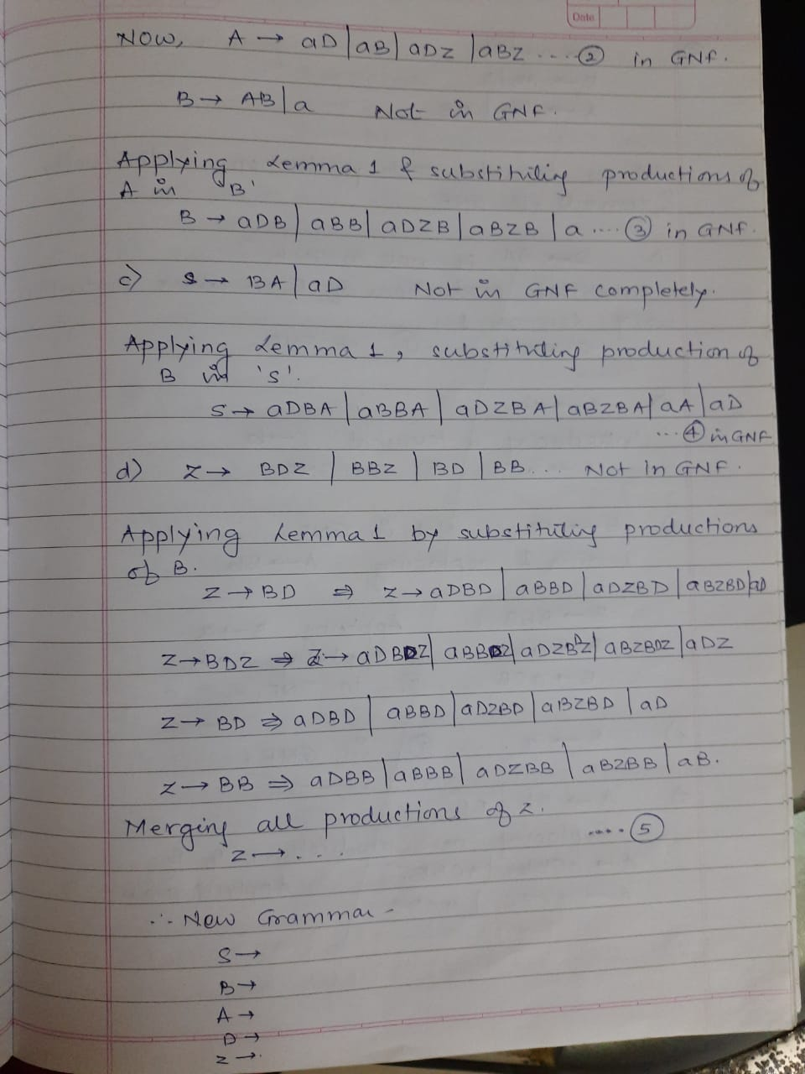

Slide 14
8. Convert the CFG to GNF
S->aSb|aX
X->Xa|Sa|a
Introducing two new Non Terminals A → a , B→ b
The grammar becomes
  S→ aSB | aX
  X → XA | SA | a
  B → b
  D → a

Slide 15
B→ b ……..1 in GNF
A → a ……. 2 in GNF
X → a …..3 in GNF
X → SA by Lemma 1 becomes…
X → aSBA | aXA
Overall… X → XA | aSBA | aXA | a
X → XA Not in GNF and this is showing Left Recursion . So, introducing a new Variable Z
X → aSBA | aXA | aSBAZ |aXAZ | a | aZ …..4 in GNF
Z → a | aZ …….. 5 in GNF
  S→ aSB | aX …… 6 in GNF

Slide 16
New Grammar G’ is :
G’ = { (A,S,B) , S , P, (a,b) }
P ➔
S→ aSB | aX
X → aSBA | aXA | aSBAZ |aXAZ | a | aZ
Z → a | aZ
A → a
B → b

Slide 17
9. Convert CFG to GNF
S → AA | 0
A → SS | 1
A → SS | 1 ….. Not in GNF
A → AAS | 0S | 1 This is showing Left Recursion
A → 0S | 0SZ | 1 | 1Z …. 1 in GNF
Z → AS | ASZ Not in GNF
Substituting A in Z
Z → 0SS | 0SSZ | 0SZS | 0SZSZ | 1S | 1SZ | 1ZS | 1ZSZ ….. 2 in GNF

Slide 18
Substituting A in S using Lemma 1
S → 0SA | 0SZA | 1A | 1ZA | 0 ……. 3 in GNF
New Grammar G’ is :
G’ = { (A,S,B) , S , P, (a,b) }
P ➔
  S → 0SA | 0SZA | 1A | 1ZA | 0
A → 0S | 0SZ | 1 | 1Z
Z → 0SS | 0SSZ | 0SZS | 0SZSZ | 1S | 1SZ | 1ZS | 1ZSZ

